Slide 1

RV College of Engineering
Go, change the world
UNIT-II
ARRAYS

Slide 2

AGENDA
RV College of Engineering
Go, change the world
Introduction
Declaration of Arrays
Accessing elements of an array,
Storing values in arrays, Operations on Arrays.
Two dimensional arrays
Operations on two dimensional arrays.

Slide 3
Introduction
RV College of Engineering
Go, change the world
An array is a collection of similar data elements.
These data elements have the same data type.
The elements of the array are stored in consecutive memory locations and are referenced by an index (also known as the subscript).
Declaring an array means specifying three things:
1. The data type- what kind of values it can store ex, int, char, float
2.Name- to identify the array
3.The size- the maximum number of values that the array can hold
Arrays are declared using the following syntax.
data_type name[size];
int arr[5]
1st element | 2nd element | 3rd element | 4th element | 5th element | 6th element | 7th element | 8th element | 9th element | 10th element
marks[0] marks[1] marks[2] marks[3] marks[4] marks[5] marks[6] marks[7] marks[8] marks[9]
Memory Representation of an Array of 10 Elements

Slide 4
Introduction
RV College of Engineering
Go, change the world
Arrays can be declared by specifying the size or the number of array elements. The size of the array specifies the maximum number of elements that the array can hold.
Eg : // declare an array by specifying size in [].
int my_array1[20];
char my_array2[5];
C does not allow declaring of the array whose number of elements is not known during compile time.
Eg : int arr[];
int n , arr[n]; // These both will results in the error
C array indices starts from 0, so for an array with N elements the index of the last element will be N-1.
C never checks the validity of array index , neither at the compile time or run time, but running such code, output will be unpredictable.

Slide 5
Introduction
RV College of Engineering
Go, change the world
The length of the array can be specified by any integer constant expression.
Eg : int arr[5];
int arr[5+5];
int arr[5*3];
int arr[-5]; Invalid
int a;
int arr [a=21/3]
Question : Can we specify the length of the array as 3.456

Slide 6
Accessing Array Elements
RV College of Engineering
Go, change the world
Array element can be accessed using array name and subscript/index written inside pair of square brackets []. Synatx : array_name[index]
For Example:
Suppose we have an integer array of length 5 whose name is marks. = int marks[5] = {5,2,9,1,1};
Now we can access elements of array marks using subscript followed by array name.
marks[0] = First element of array marks = 5, marks[1] = Second element of array marks = 2
To access all the elements of the array, you must use a loop. That is, we can access all the elements of the array by varying the value of the subscript into the array.
Note that the subscript must be an integral value or an expression that evaluates to an integral value. For Example : int i, marks[10];
for(i=0;i<10;i++)
marks[i] = -1;

Slide 7
Specify the array length
RV College of Engineering
Go, change the world
There are two ways to specify the array length
1 . int arr[10] // This creates the array with 10 elements
2. Specifying using Macros
#define N 10
int arr[N];
Which is the best way to define the arrays and why?

Slide 8
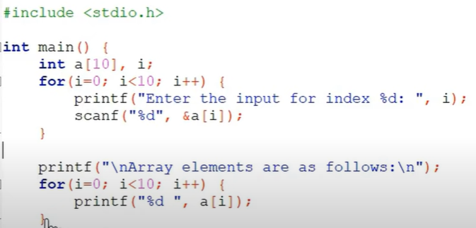
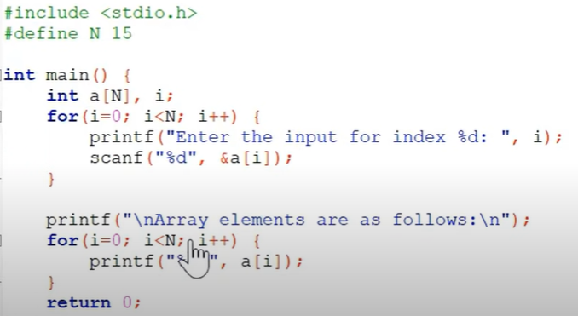
Best way to Define Arrays

Slide 9
CALCULATING THE ADDRESS OF ARRAY ELEMENTS
RV College of Engineering
Go, change the world
Address of data element, A[k] = BA(A) + w( k – lower_bound index)
Here, A is the array
k is the index of the element of which we have to calculate the address
BA is the base address of the array A.
w is the word size of one element in memory, for example, size of int is 2. Given an array of int marks
Marks[0] marks[1] marks[2] marks[3] marks[4] marks[5] marks[6] marks[7]
1000 1002 1004 1006 1008 1010 1012 1014
Marks[4] = 1000 + 2(4 – 0)
= 1000 + 2(4) = 1008

Slide 10
CALCULATING THE Length OF ARRAY
RV College of Engineering
Go, change the world
The general formula to calculate the length of the array is
Length = upper_bound – lower_bound+1
Upper_bound is the index of last element and lower bound is the index of first element
int marks[5] = {5,2,9,1,1};
Length = 4-0+1 = 5

Slide 11
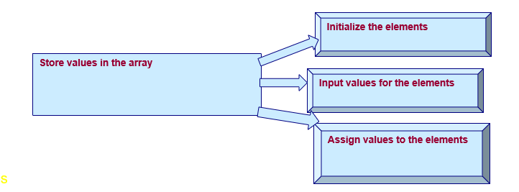
STORING VALUES IN ARRAYS
RV College of Engineering
Go, change the world
There are three ways to store the values in the array and they are, as shown in below figure

Slide 12
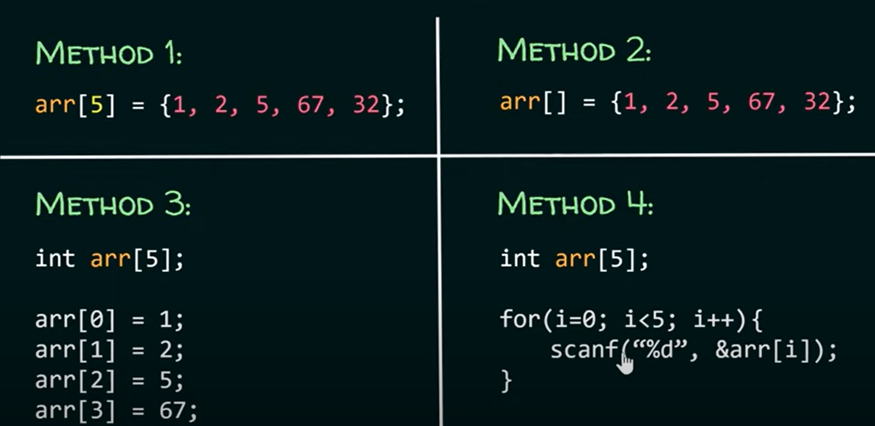
Initializing Array during Declaration
RV College of Engineering
Go, change the world

Slide 13
Initializing Array during Declaration
RV College of Engineering
Go, change the world
Array are initialized by writing
Type array_name[size] = {list of the values}
Eg : int marks[5] = {5,2,9,1,1};
Now we can access elements of array marks using subscript followed by array name.
marks[0] = First element of array marks = 5, marks[1] = Second element of array marks = 2
While initializing the array at the time of deceleration the programmer may omit the size of the array
int marks[] = {5,2,9,1,1};
If the number of elements provided is less than the number of elements in the array, the unsigned elements are filled with zeroes.
If we have more elements provided then the number of elements declared it will generate the compile error

Slide 14
Initializing Array – Input the Values from Key Board
RV College of Engineering
Go, change the world
An array can also be initialized using a loop. The loop iterates from 0 to (size - 1) for accessing all indices of the array starting from 0.
The following syntax uses a “for loop” ‘”while loop” or “do-while”to initialize the array elements. This is the most common way to initialize an array in C.
Eg :
int my_array[5];
// initialize array using a "for" loop.
int i;
for(i = 0; i < 5; i++)
{
my_array[i] = 2 * i;
}
// my_array = {0, 2, 4, 6, 8}
In the above syntax, an array of size 5 is declared first. The array is then initialized using a for loop that iterates over the array starting from index 0 to (size - 1).

Slide 15
Initializing Array – Assigning values to Induvial Elements
RV College of Engineering
Go, change the world
The values can be assigned to the induvial elements of the array by using the assignment operator.
Eg : marks[3] = 100;
Here the 100 is assigned to the fourth element of the array.
We can not assign the one array to the other array, though they may have same size and type.
To copy the array, we must copy the every element of the first array to the element of the second array

Slide 16
Operations on array in C
RV College of Engineering
Go, change the world
There are a number of operations that can be performed on an array which are:
Traversal
Insertion
Deletion
Searching
Merging
Sorting

Slide 17
Operations on array in C- Traversal
RV College of Engineering
Go, change the world
Traversal means accessing each array element for a specific purpose, either to perform an operation on them , counting the total number of elements or else using those values to calculate some other result.
Since array elements is a linear data structure meaning that all elements are placed in consecutive blocks of memory it is easy to traverse them.
Algorithm: Consider A[]is the array:
Step 1: Initialise counter C = lower_bound_index
Step 2: Repeat steps 3 to 4 while c ≤upper_bound_index
Step 3: Apply the specified operation on A[c]
Step 4: Increment counter : C = C + 1
[Loop Ends] A=
Step 5: Exit 0 1 2 3 4 5
A | B | C | D | E | F

Slide 18
Operations on array in C-Inserting
RV College of Engineering
Go, change the world
Inserting an element in array means adding a new data element to already existing array.
If the array has to be added at the end of existing array - Just add 1 to the upper_bound and assign the value
Algorithm
Step 1: Set upper_bound = upper_bound+1
Step2: Set A[upper_bound] =VAL
Step 3 :Exit
Assume :Memory Space is available

Slide 19
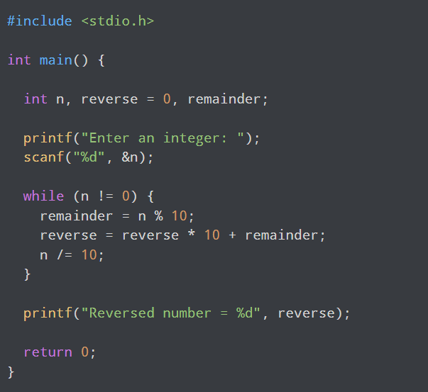
C –Program to reverse the number

Slide 20
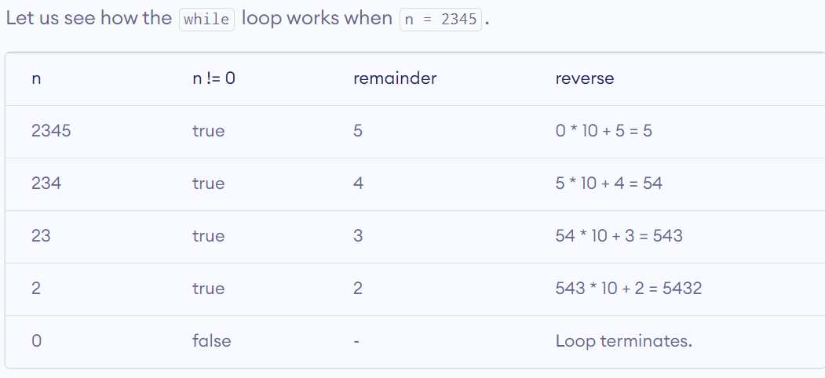
C –Program to reverse the number

Slide 21
Assignment - C –Program to reverse the array of numbers 1. Write a Program to print the following numbers in reverse order 22,33,44,55,66,77,88,99 2. Write a program to check any of digits in a number appears more than one time

Slide 22
Operations on array in C-Inserting
RV College of Engineering
Go, change the world
Inserting an element in array in the middle of the array
The algorithm INSERT will be declared as INSERT( A, N, POS, VAL)
.A- Size of the Array
N- Number of elements in array
Pos - At what pos we need to insert
Val - What value has to be inserted

Slide 23
Step 1: [INITIALIZATION] SET I = N
Step 2: Repeat Steps 3 and 4 while I >= POS
Step 3: SET A[I + 1] = A[I]
Step 4: SET I = I – 1
[End of Loop]
Step 5: SET N = N + 1
Step 6: SET A[POS] = VAL
Step 7: EXIT

Slide 24
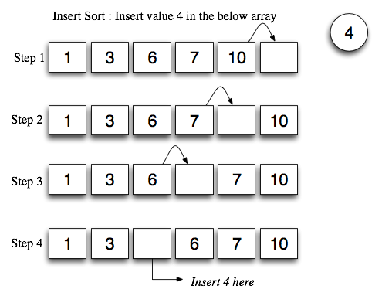

Slide 25
Operations on array in C-Deleting
RV College of Engineering
Go, change the world
DELETE( A, N, POS,ITEM)
Step 1: [INITIALIZATION] SET ITEM = A[K]
Step 2: Repeat for I = K to N-1
Step 3: SET A[I] = A[I+1]
[End of Loop]
Step 4: SET N = N - 1
Step 5: EXIT

Slide 26
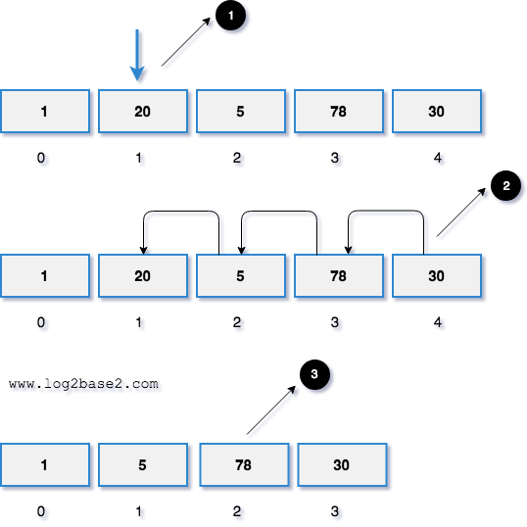
Operations on array in C-Deleting
RV College of Engineering
Go, change the world

Slide 27
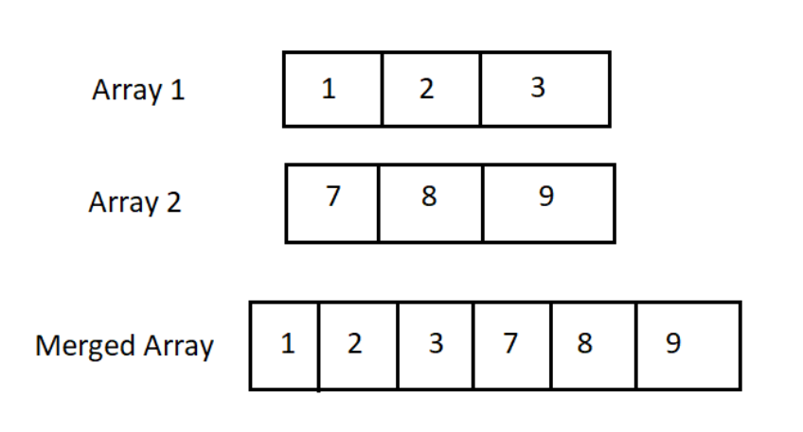
Operations on array in C-Merging
RV College of Engineering
Go, change the world
Merging two arrays means combining two separate arrays into one single array.
For instance, if the first array consists of 3 elements and the second array consists of 5 elements then the resulting array consists of 8 elements.
This resulting array is known as a merged array.
We are given two sorted arrays and our task is to merge these two sorted arrays.
Input: First Array: 5 4 3 2 1
Second Array: 9 8 7 6 5
Output: Merged sorted Array: 9 8 7 6 5 5 4 3 2 1

Slide 28
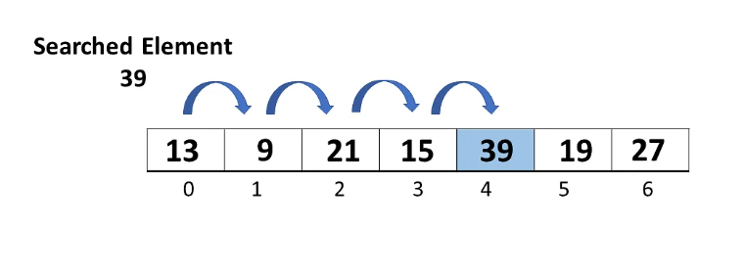
Searching of Value in an Array
RV College of Engineering
Go, change the world
LINEAR SEARCH
Linear search, often known as sequential search, is the most basic search technique.
In this type of search, you go through the entire list and try to fetch a match for a single element.
If you find a match, then the address of the matching target element is returned.
On the other hand, if the element is not found, then it returns a NULL value.

Slide 29
Searching of Value in an Array
RV College of Engineering
Go, change the world
The procedures for implementing linear search are as follows:
Step 1: First, read the search element (Target element) in the array.
Step 2: In the second step compare the search element with the first element in the array.
Step 3: If both are matched, display "Target element is found" and terminate the Linear Search function.
Step 4: If both are not matched, compare the search element with the next element in the array.
Step 5: In this step, repeat steps 3 and 4 until the search (Target) element is compared with the last element of the array.
Step 6 - If the last element in the list does not match, the Linear Search Function will be terminated, and the message "Element is not found" will be displayed.

Slide 30
Searching of Value in an Array
RV College of Engineering
Go, change the world
Linear Search ( Array Arr, Value a ) // Arr is the name of the array, and a is the searched element. In example a=39, n = 6
Step 1: Set i to 0 // i is the index of an array which starts from 0
Step 2: if i > n then go to step 7 // n is the number of elements in array
Step 3: if Arr[i] = a then go to step 6
Step 4: Set i to i + 1
Step 5: Goto step 2
Step 6: Print element a found at index i and go to step 8
Step 7: Print element not found
Step 8: Exit

Slide 31
Searching of Value in an Array
RV College of Engineering
Go, change the world
BINARY SEARCH
BEG = lower_bound and END = upper_bound
MID = (BEG + END) / 2
If VAL < A[MID], then VAL will be present in the left segment of the array. So,
the value of END will be changed as, END = MID – 1
If VAL > A[MID], then VAL will be present in the right segment of the array. So,
the value of BEG will be changed as, BEG = MID + 1

Slide 32
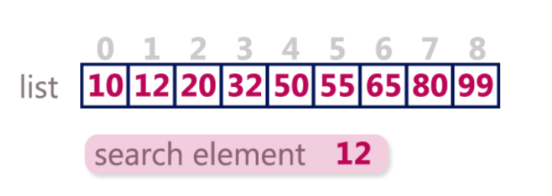
Searching of Value in an Array-Binary Search
RV College of Engineering
Go, change the world
Binary search is implemented using following steps...
Step 1 - Read the search element from the user.
Step 2 - Find the middle element in the sorted list. = int(beggning+ending)/2
Step 3 - Compare the search element with the middle element in the sorted list.
Step 4 - If both are matched, then display "Given element is found!!!" and terminate the function.
Step 5 - If both are not matched, then check whether the search element is smaller or larger than the middle element.
Step 6 - If the search element is smaller than middle element, repeat steps 2, 3, 4 and 5 for the left sublist of the middle element.
Step 7 - If the search element is larger than middle element, repeat steps 2, 3, 4 and 5 for the right sublist of the middle element.
Step 8 - Repeat the same process until we find the search element in the list or until sub list contains only one element.

Slide 33
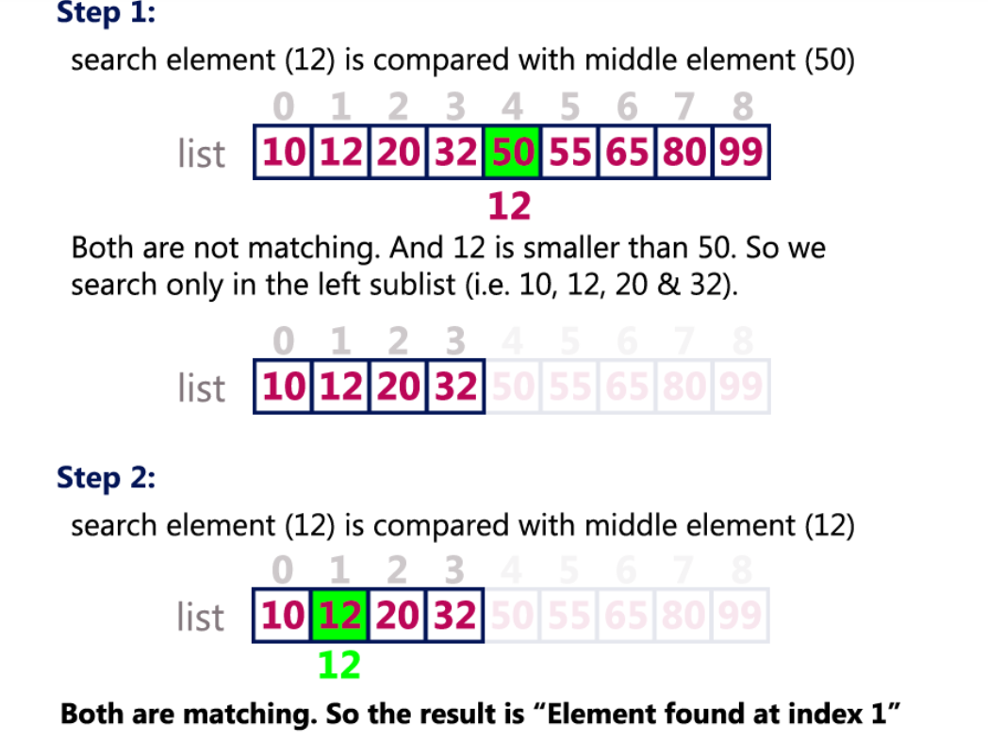
Searching of Value in an Array-Binary Search
RV College of Engineering
Go, change the world
.

Slide 34
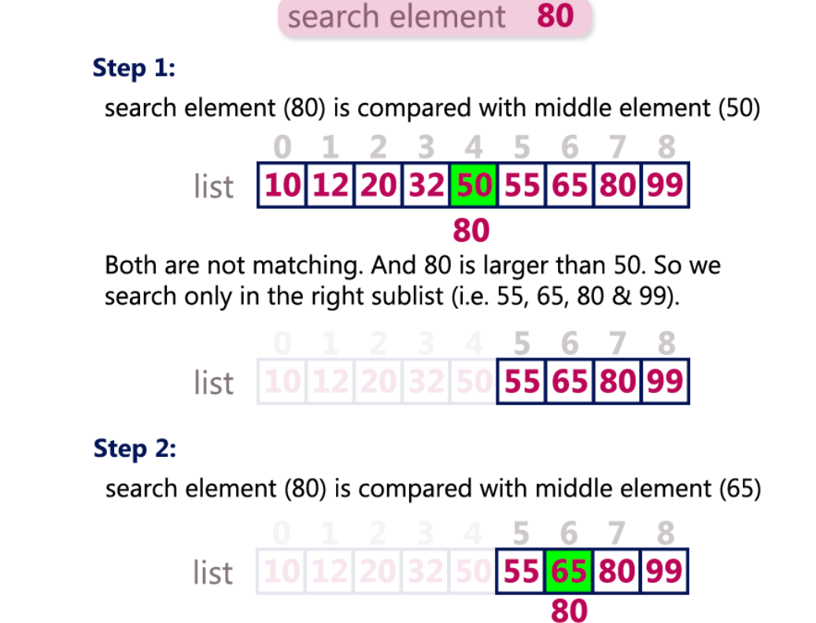
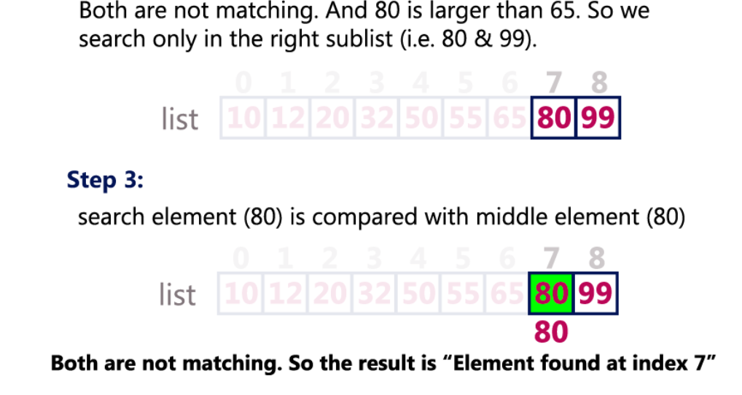
Searching of Value in an Array-Binary Search
RV College of Engineering
Go, change the world
.

Slide 35
Operations on array in C-Binary Search
RV College of Engineering
Go, change the world
Step 1: Set beg = lower bound , end = Upperbound mid = int(beg+end)/2
Step 2: Repeat 3 and 4 while beg ≤ end and a[mid]! = item
Step 3: if item < a[mid] then
Set end = end-1
Else
Beg = beg+1 Search element = 8
Setp 4 mid = int(beg+end)/2 go to step 2
Step 5 a[mid] = item
Loc =mid
Else
Element not found
[
2 | 3 | 5 | 8 | 9

Slide 36
Searching of Value in an Array-Binary Search
RV College of Engineering
Go, change the world
Beg = 0
End= 4
Mid = 2
0 is less than 4 and a[2] is not 8
New value of beg will be 3
A[3] is 8

Slide 37
Searching of Value in an Array-Binary Search
RV College of Engineering
Go, change the world
int A[] = {0, 1, 2, 3, 4, 5, 6, 7, 8, 9, 10};
and VAL = 9, the algorithm will proceed in the following manner.
BEG = 0, END = 10, MID = (0 + 10)/2 = 5
Now, VAL = 9 and A[MID] = A[5] = 5
A[5] is less than VAL, therefore, we will now search for the value in the later half of the array. So, we change the values of BEG and MID.
Now, BEG = MID + 1 = 6, END = 10, MID = (6 + 10)/2 =16/2 = 8
Now, VAL = 9 and A[MID] = A[8] = 8
A[8] is less than VAL, therefore, we will now search for the value in the later half of the array. So, again we change the values of BEG and MID.
Now, BEG = MID + 1 = 9, END = 10, MID = (9 + 10)/2 = 9
Now VAL = 9 and A[MID] = 9.
Now VAL = 9 and A[MID] = 9.

Slide 38
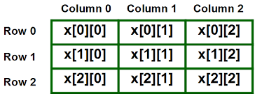
Two Dimensional Arrays
RV College of Engineering
Go, change the world
Two Dimensional Arrays can be thought of as an array of arrays or as a matrix consisting of rows and columns.

Slide 39
Declaration of two dimensional Array in C
RV College of Engineering
Go, change the world
Two Dimensional Arrays can be thought of as an array of arrays or as a matrix consisting of rows and columns.
The syntax to declare the 2D array is given below.
data_type array_name[rows][columns];
Consider the following example.
int twodimen[4][3];
Here, 4 is the number of rows, and 3 is the number of columns

Slide 40
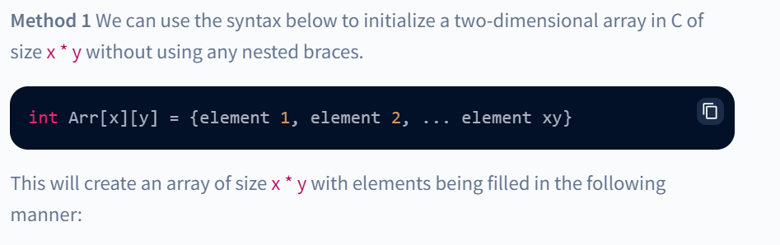
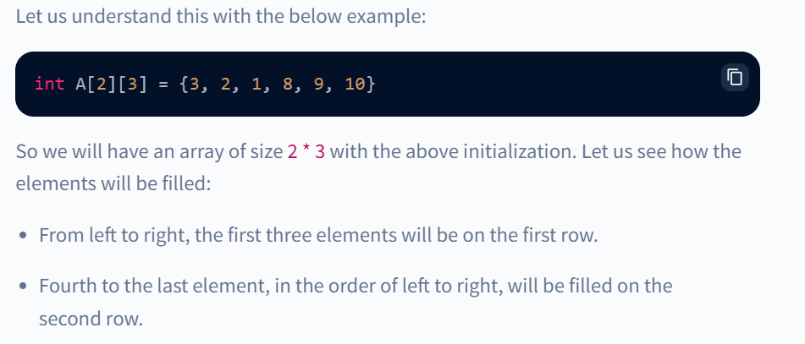
Initializing of two-dimensional Array in C
RV College of Engineering
Go, change the world
There are two ways to initialize a two-Dimensional arrays during declaration.

Slide 41
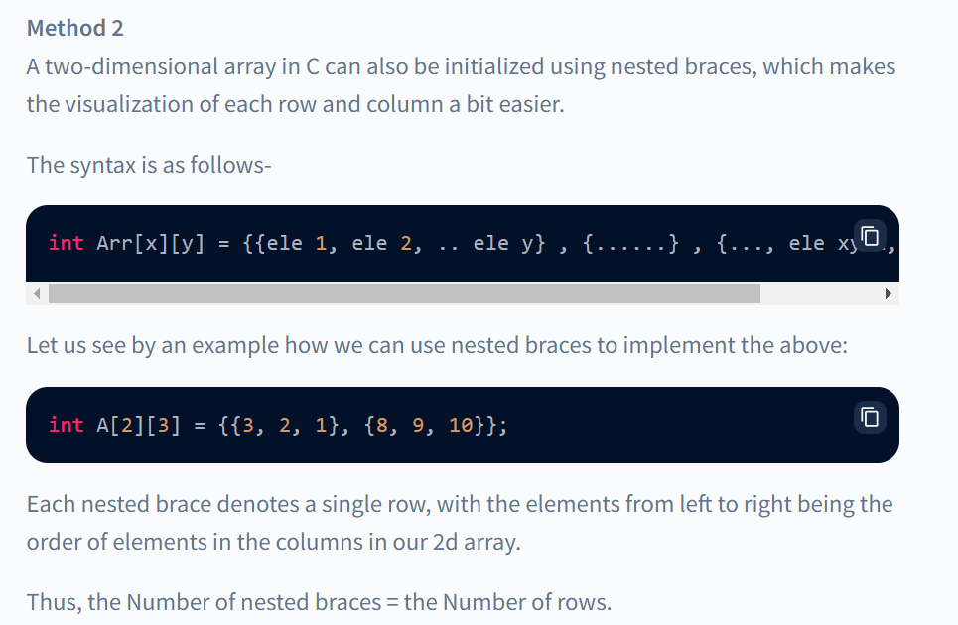
Initializing of two-dimensional Array in C
RV College of Engineering
Go, change the world
There are two ways to initialize a two-Dimensional arrays during declaration.

Slide 42
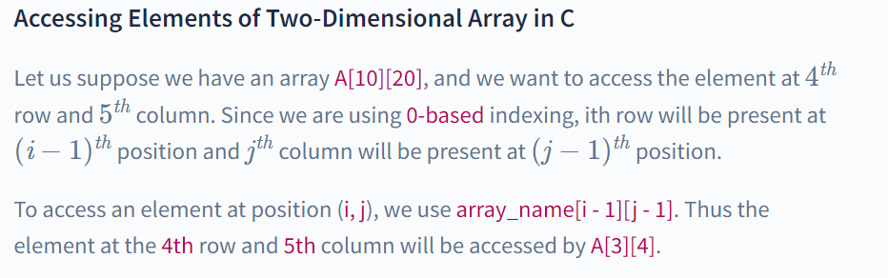
Accessing element of two-dimensional Array in C
RV College of Engineering
Go, change the world

Slide 43

Operations of two dimensional Array in C
RV College of Engineering
Go, change the world
Two dimensional arrays can be used to implement concept of matrices
Transpose : Transpose of m×n matrix A is given as n×m matrix B , where
Bi,j = Ai,j
2. Sum = Ci,j = Ai,j + Bi,j = Two matrix which are compatible can be added and the result will be stored in other matrix
3. Difference = Ci,j = Ai,j - Bi,j =Two matrix which are compatible can be subtracted and the result will be stored in other matrix
4. Product = Two matrix can be multiplied with each other if the number of columns in first matrix is equal to number of rows in second matrix

Slide 44


